Slide 1
A Mostly-Clean DRAM Cache for Effective Hit Speculation and Self-Balancing Dispatch
Jaewoong Sim Gabriel H. Loh Hyesoon Kim
Mike O’Connor Mithuna Thottethodi

Slide 2
Outline
Motivation & Key Ideas
Overkill of MissMap (HMP)
Under-utilized Aggregate Bandwidth (SBD)
Obstacles Imposed by Dirty Data (DiRT)
Mechanism Design
Experimental Results
Conclusion

Slide 3
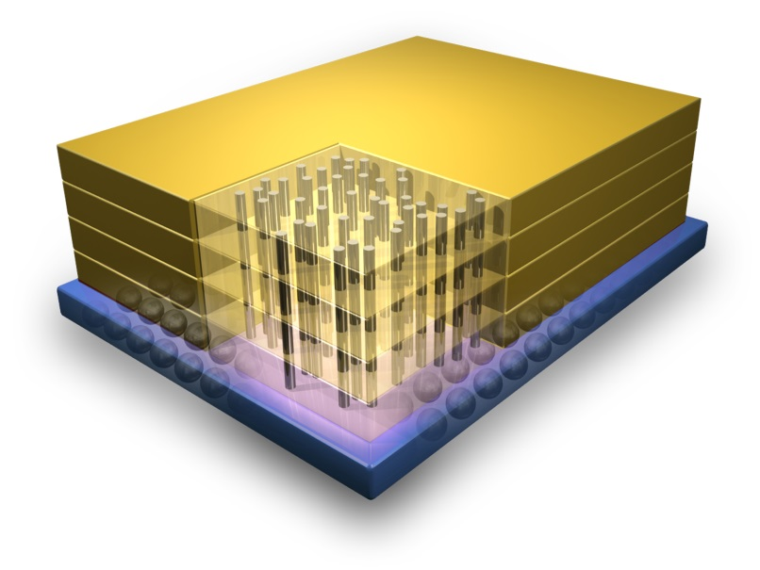
Die-Stacked DRAM
Die-stacking technology is NOW!
Q: How to use of stacked DRAM?
Two main usages
Usage 1: Use it as main memory
Usage 2: Use it as a large cache (DRAM cache)
Same Tech/Logic
(DRAM Stack)
Hundreds of MBs On-Chip Stacked DRAM!!
Through-Silicon Via
(TSV)
Processor Die
Credit: IBM
This work is about the DRAM cache usage!

Slide 4
DRAM Cache: State of the Art
DRAM Cache Organization: Loh and Hill [MICRO’11]
1st Innovation: TAG and DATA blocks are placed in the same row
Accessing both without closing/opening another row => Reduce Hit Latency
2nd Innovation: Keep track of cache blocks installed in the DRAM$ (MissMap)
Avoiding DRAM$ access on a miss request => Reduce Miss Latency
However, still has some inefficiencies!
Row Decoder
3 tag blocks
29 data blocks
Tags are embedded!!
…
Row X
DRAM (2KB ROW, 32 blocks for 64B line)
Not Found!
Do not access DRAM$
Found!
Send to DRAM$
Record the existence of the cacheline!
Memory Request
Sense Amplifier
On a hit, we can get the data from the row buffer!
MissMap
Check MissMap
for every request
DRAM Bank

Slide 5
Problem (1): MissMap Overhead
MissMap is expensive due to precise tracking
Size: 4MB for 1GB DRAM$
Latency: 20+ cycles
Where to architect this?
MissMap
Added to every memory request!
Miss Latency (original)
ACT
CAS
TAG
Off-Chip Memory
Miss Latency (MissMap)
MissMap
Off-Chip Memory
Reduced!
20+ cycles
20+ cycles
Hit Latency (original)
ACT
CAS
TAG
DATA
Increased!
Hit Latency (MissMap)
MissMap
ACT
CAS
TAG
DATA

Slide 6
Problem (1): MissMap Overhead
Avoiding the DRAM cache access on a miss is necessary
Question: How to provide such benefit at low-cost?
Possible Solution: Use Hit-Miss Predictor (HMP)
Cases of imprecise tracking
False Positive: Prediction: Hit, Actual: Miss (this is OK)
False Negative: Prediction: Miss, Actual: Hit (problem)
Observation: DRAM tags are always checked at installation time on a DRAM cache miss
False negative can be identified, but
HMP would be a more nice solution by solving dirty data issue!
Less Size ☺
Dirty Data ☹
Must wait for the verification of predicted miss requests!

Slide 7
Problem (2): Under-utilized BW
DRAM caches ≠ SRAM caches
Latency: DRAM caches >> SRAM caches
Throughput: DRAM caches << SRAM caches
Hit requests often come in bursts
SRAM caches: Makes sense to send all the hit requests to the cache
DRAM caches: Off-chip memory can sometimes serve the hit requests faster
Always send hit requests to DRAM$?
Stacked
DRAM$
Req. Buffer
Another Hit Requests
Off-chip
Memory
Req. Buffer
Off-chip BW would be under-utilized!

Slide 8
Problem (2): Under-utilized BW
Some hit requests are also better to be sent to off-chip memory
This is not the case in SRAM caches!
Possible Solution: Dispatch hit requests to the shorter latency memory source
We call it Self-Balancing Dispatch (SBD)
Now, we can utilize overall system BW better ☺
Wait. What if the cache has the dirty data for the request?
Solving under-utilized BW problem is critical
But, SBD may not be possible due to dirty data!
Seems to be a simple problem ☺
Dirty Data! ☹

Slide 9
Problem (3): Obstacles by Dirty Data
Dirty data restrict the effectiveness of HMP and SBD
Question: How to guarantee the non-existence of dirty blocks?
Observation: Dirty data == byproduct of write-back policy
Key Idea: Make use of write policy to deal with dirty data
For many applications, very few pages are write-intensive
Solution: Maintain a mostly-clean DRAM$ via region-based WT/WB policy
Dirty Region Tracker (DiRT) keeps track of WB pages
But, we cannot simply use WT policy!
Clean or Dirty?
# of writes
2
0
0
9
0
8
1
0
4KB regions (pages)
Clean!!
Write-Back
2
0
0
9
0
8
1
0
Write-Through
4KB regions (pages)

Slide 10
Summary of Solutions
Problem 1 (Costly MissMap) Hit-Miss Predictor (HMP)
Eliminating MissMap + Look-up latency for every request
Problem 2 (Under-utilized BW) Self-Balancing Dispatch (SBD)
Dispatch hit request to the shorter latency memory source
Problem 3 (Dirty Data) Dirty Region Tracker (DiRT)
Help identify whether dirty cache line exists for a request
Mechanism
START
DiRT
HMP
SBD
Dirty Request?
YES
DRAM$ Queue
NO
YES
Predicted Hit?
E(DRAM$) <
E(DRAM)
YES
NO
NO
DRAM Queue
These are nicely working together!
E(X): Expected Latency of X

Slide 11
Outline
Motivation & Key Ideas
Design
Hit-Miss Predictor (HMP)
Self-Balancing Dispatch (SBD)
Dirty Region Tracker (DiRT)
Experimental Results
Conclusion

Slide 12
Hit-Miss Predictor (HMP)
Goal: Replace MissMap with lightweight structure
1) Practical Size, 2) Reduce Access Latency
Challenges for hit miss prediction
Global hit/miss history for memory requests is typically not useful
PC information is typically not available in L3
Our HMP is designed to input only memory address
Question: How to provide good accuracy with memory information?
Key Idea 1: Page (segment)-level tracking & prediction
Within a page, hit/miss phases are distinct
High Prediction Accuracy!

Slide 13
HMPregion: Region-Based HMP
Miss
Phase
Hit
Phase
Miss
Phase
Hit
Phase
Increasing on misses
Flat on hits
A page from leslie3d in WL-6
Two-bit bimodal predictor per 4KB region
A lot smaller than MissMap (512KB vs 4MB for 8GB physical memory)
Can we further optimize the predictor?
Key Idea 2: Use Multi-Granular regions
Hit-miss patterns remain fairly stable across adjacent pages
Needs a few cycles to access HMP
A single predictor for regions larger than 4KB

Slide 14
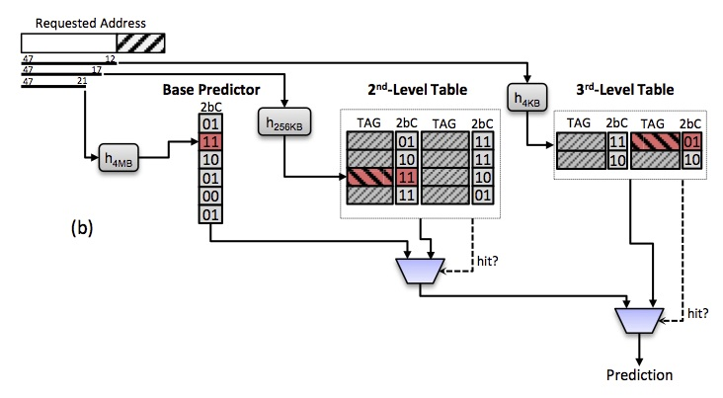
HMPMG: Multi-Granular HMP
FINAL DESIGN: Structurally inspired by TAGE predictor (Seznec and Michaud [JILP’06])
Base Predictor: default predictions
Tagged Predictors: predictions on tag matching
Next-level predictor overrides the results of previous-level predictors
95+% prediction accuracy with less-than-1KB structure!!
Use prediction result from 3rd-level table!
Base: 4MB
2nd-Level: 256KB
3rd-Level: 4KB
Operation details can be found in the paper!
Tracking Regions

Slide 15
Self-Balancing Dispatch (SBD)
IDEA: Steering hit requests to off-chip memory
Based on the expected latency of DRAM and DRAM$
How to compute expected latency?
N: # of requests waiting for the same bank
L: Typical latency of one memory request (excluding queuing delays)
Expected Latency (E) = N * L
Steering Decision
E(off-chip) < E(DRAM_Cache): Send to off-chip memory
E(off-chip) >= E(DRAM_Cache) : Send to DRAM cache
Simple but effective!!

Slide 16
Dirty Region Tracker (DiRT)
IDEA: Region-based WT/WB operation (dirty data)
WB: write-intensive regions. WT: others
DiRT consists of two hardware structures
Counting Bloom Filter: Identifying write-intensive pages
Dirty List: Keep track of write-back-operated pages
Write Request
Hash A
Hash B
Hash C
Pages captured in Dirty List are operated with WB!
#writes > threshold
WB Pages
NRU
TAG
Counting Bloom Filters
Dirty List

Slide 17
Outline
Motivation & Key Ideas
Design
Experimental Results
Methodology
Performance
Effectiveness of DiRT
Conclusion

Slide 18
Evaluations - Methodology
System Parameters
Workloads
CPU
Core L1 Cache L2 Cache | 4 cores, 3.2GHz OOO 32KB I$ (4-way), 32KB D$(4-way) 16-way, shared 4MB
Stacked DRAM Cache
Cache Size Bus Frequency Chans/Ranks/Banks | 128 MB 1.0 GHz (DDR 2.0GHz), 128 bits per channel 4/1/8, 2048 bytes row buffer
Off-chip DRAM
Bus Frequency Chans/Ranks/Banks tCAS-tRCD-tRP | 800 MHz (DDR 1.6GHz), 64 bits per channel 2/1/8, 16KB bytes row buffer 11-11-11
Mix | Workloads
WL-1 | 4 x mcf
WL-2 | 4 x lbm
WL-3 | 4 x leslie3d
WL-4 | mcf-lbm-milc-libquantum
WL-5 | mcf-lbm-libquantum-leslie3d
WL-6 | libquantum-mcf-milc-leslie3d
WL-7 | mcf-milc-wrf-soplex
WL-8 | milc-leslie3d-GemsFDTD-astar
WL-9 | libquantum-bwaves-wrf-astar
WL-10 | bwaves-wrf-soplex-GemsFDTD

Slide 19
Evaluations - Performance
Need verification for predicted miss requests
With DiRT support, HMP becomes very effective!!
HMP is worse than MM for many WLs
20.3% improvement over baseline
HMP without DiRT does not work well!
15.4% more over MM
Not better than the baseline
MM improves
AVG performance

Slide 20
Evaluations - Effectiveness of DiRT
CLEAN:
Safe to apply HMP/SBD
WT traffic >> WB traffic
DiRT traffic ~ WB traffic

Slide 21
Outline
Motivation & Key Ideas
Design
Experimental Results
Conclusion

Slide 22
Conclusion
Problem: Inefficiencies in current DRAM cache approach
Multi-MB/High-latency cache line tracking structure (MissMap)
Under-utilized aggregate system bandwidth
Solution: Speculative approaches
Replace MissMap with a less-than-1KB Hit-Miss Predictor (HMP)
Dynamically steer hit requests either to DRAM$ or off-chip DRAM (SBD)
Maintain a mostly-clean DRAM cache with Dirty Region Tracker (DiRT)
Result: Make DRAM cache approach more practical
20.3% faster than no DRAM cache (15.4% over the state-of-the-art)
Removed 4MB storage requirement (so, much more practical)
IDEA: Region-Based Prediction!
+ TAGE Predictor-like Structure!
IDEA: Hybrid Region-Based WT/WB policy for DRAM$!

Slide 23
Q/A
Thank you!

