Slide 1
Resilient Die-stacked DRAM Caches
Jaewoong Sim*, Gabriel H. Loh⁺, Vilas Sridharan#, Mike O’Connor⁺
June 2013
*Georgia Tech
⁺AMD Research
#AMD RAS Architecture

Slide 2
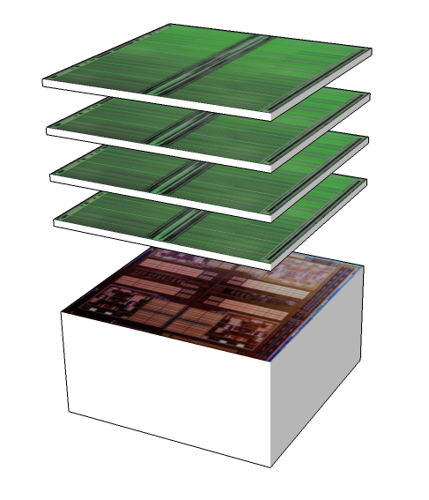
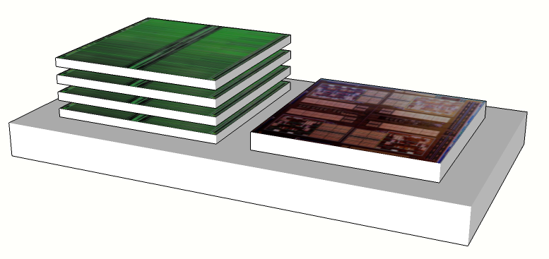
Die-stacked Memory
Die-stacking is coming along, esp. DRAM
  JEDEC Wide-IO and HBM standards
  Micron Hybrid Memory Cube™
For the time being, likely to be utilized in more
expensive, higher-end product segments
  HPC, Data-Center, Gaming/Enthusiast GPU
For HPC, Data-Center, may not be able to
stack enough DRAM for target capacities
  Perhaps for some segments or Cloud
  application classes, but not for others (e.g., HPC)
Past work has explored how to utilize stacked
DRAM as a large, SW-transparent cache
  E.g., the previous excellent EPFL talk
DRAM layers
cores
DRAM layers
cores
silicon interposer

Slide 3

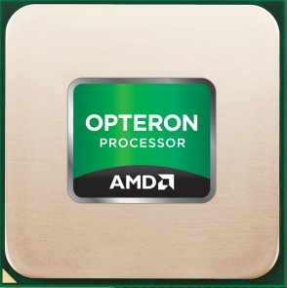
Serviceability
Die-stacked DRAM changes the Serviceability of memory
Conventional DRAM:
$
X
Stacked DRAM + CPU:
X
$$$

Slide 4
RAS Needs in High-Availability Systems
Soft errors
  Transient errors (high-energy particle strikes, PVT)
Hard failures
  Very common in practice
  Example: ORNL’s Jaguar cluster [Sridharan+ SC12]
    41% transient faults, 59% permanent
    Many “coarse-grain failures”, e.g.,
    row-level, entire bank
Fault-tolerance critical in HPC
  Scientific simulations can take weeks to
  months; uncorrectable errors are very
  expensive (even with checkpoint restore)
  Even worse: Silent Data Corruption
    Months of simulation for a wrong answer, and you don’t even know it
Fault Type | FIT Rate
Single-bit, transient | 14.2
Single-column, permanent | 5.6
Single-row, permanent | 8.2
Single-bank, permanent | 10.0

Slide 5
Flexibility and Cost
Conventional DRAM uses the same chips for non-ECC and ECC DIMMs
ECC DIMM
Non-ECC DIMM
Data: Eight x8 DRAM chips
Data: Eight x8 DRAM chips
ECC: One x8 DRAM chip
Memory vendor only needs to design a single DRAM chip
  +12.5% storage for SECDED: just add one (x8) or two (x4) extra chips
  DIMM PCB design a lot cheaper

Slide 6

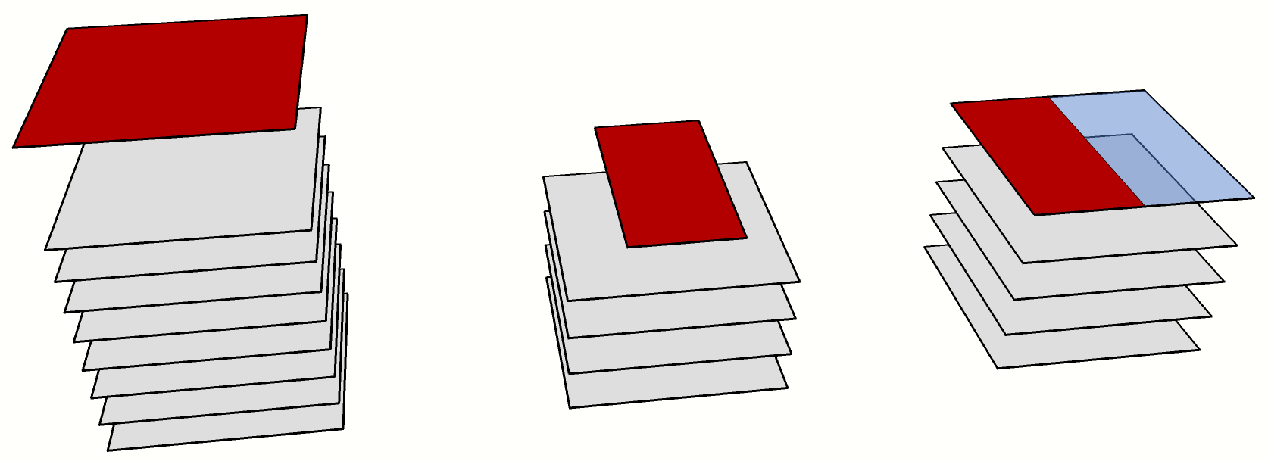
How to Add 12.5% Storage to 3D DRAM?
Make row 12.5% wider?
  Memory vendor must support two different ICs
Add more chips?
9th DRAM
chip (ECC)
½ DRAM chip
for ECC (?)
(½ wasted)
5th DRAM
chip (ECC)
4 DRAM chips (data)
8 DRAM chips (data)
4 DRAM chips (data)
Not practical;
Stacking concerns
Wasteful
Extra cost
Must have 8 chips

Slide 7
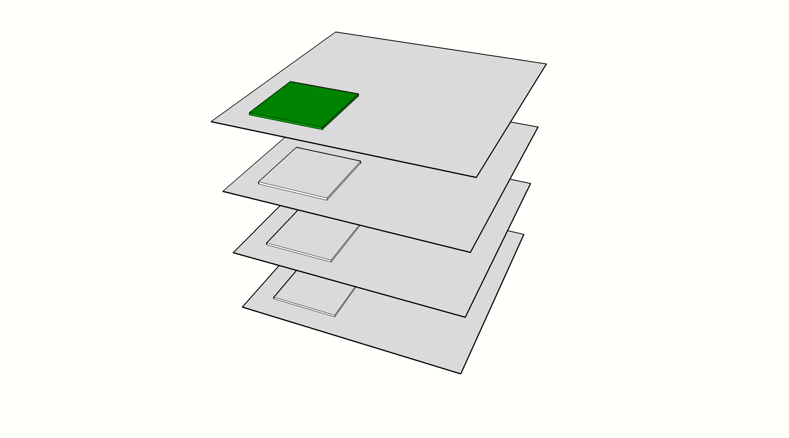
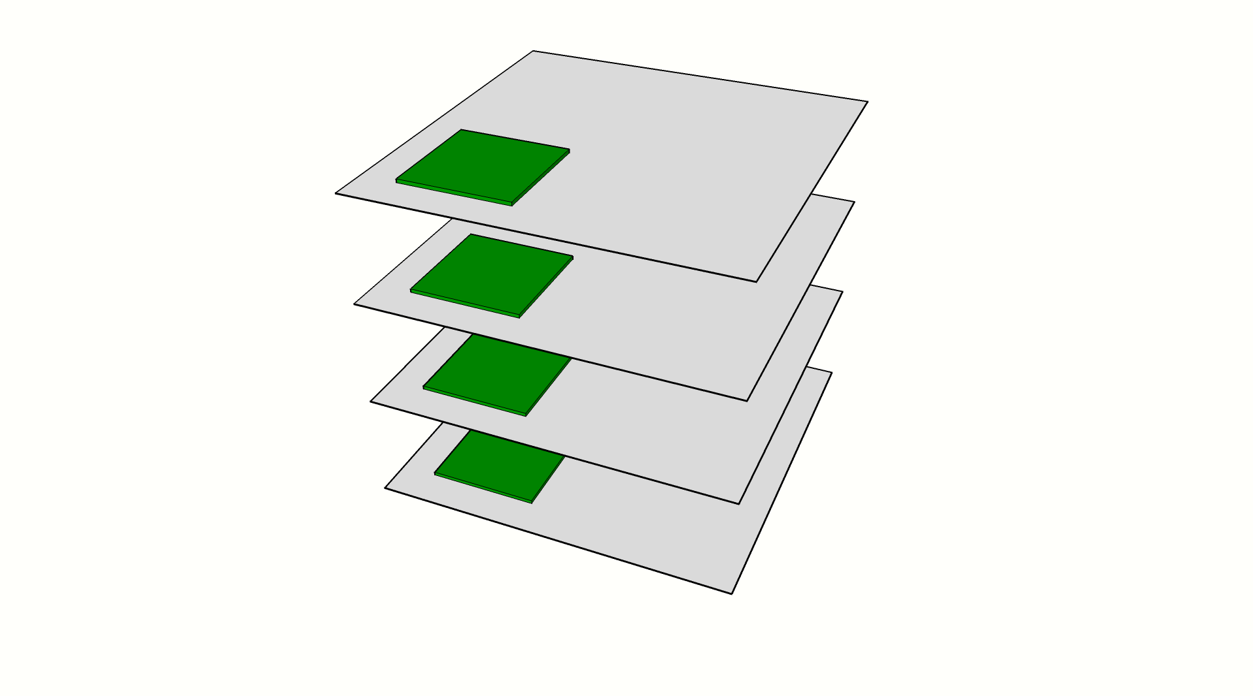
Die-stacked DRAM Organization
“DIMM-style” ECC for stacked DRAM is expensive
128b
32b
32b
32b
32b
3D DRAM uses wide buses
  E.g., JEDEC HBM has eight independent 128-bit channels
Single-point of failure
  Chip-kill works because data are spread out over multiple physical units of failure
Accessing multiple chips
  Wastes channel/command BW
  Reduces opportunities for BLP
  Wastes power (multiple activations)

Slide 8
Executive Summary Slide
Comprehensive error-detection and correction for DRAM caches
  Basic error correction: all single-bit upsets correctable
  Coarse-grain error correction: 99.9993% of single-column, row, and bank failures
  Superior SDC protection: 5 orders of magnitude reduction in SDC FIT rate compared to basic SECDED ECC
Many existing techniques, synthesized specifically for DRAM caches
  Basic SEC (no extra detection) for common single-bit upsets
  CRC for very strong multi-bit detection
  Address/index hashing for decoder failure detection
  Duplicate-on-Write: RAID1-like approach for correction
Low-cost, Flexible, and General
  Works with non-ECC, unmodified stacked DRAM
    HBM-like interface used in this study
  Can be optionally enabled for different market segments/needs
  A specific design is presented, but this is a general framework to support RAS in DRAM caches

Slide 9
Basic Error Detection and Correction

Slide 10
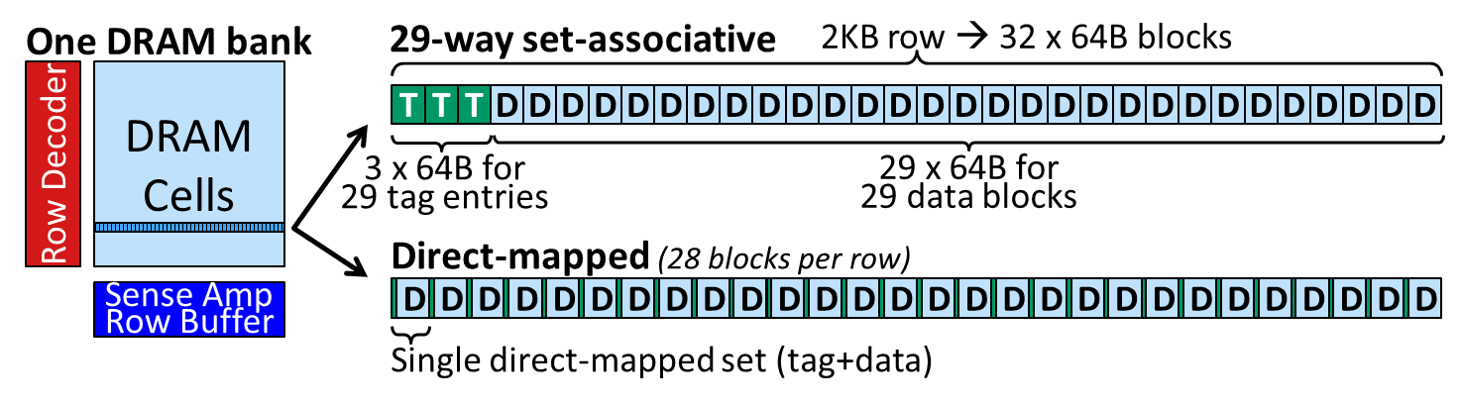
DRAM Cache Review
To mitigate space overheads of external tag overheads, tags and data are
co-located with DRAM rows
  Loh and Hill [MICRO11] developed initial set-associative solution
  Qureshi and Loh [MICRO12] proposed direct-mapped organization for latency
Both use unmodified stacked DRAM: tags and data laid out differently, but the underlying storage is just a standard DRAM row
Key observation: tags, data (and anything else) are fungible
  Can allocate more or less of one type or the other; just depends on how the memory/cache controller interprets what’s stored in a row

Slide 11
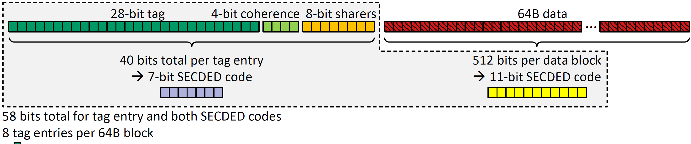
Embedding ECC in a Row

Slide 12
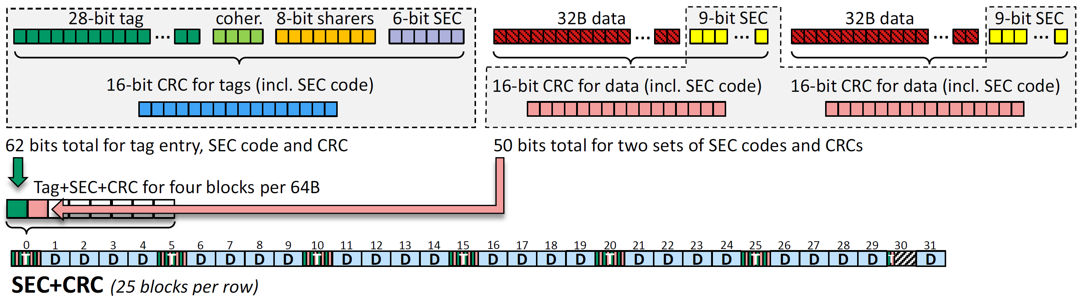
Enhancing Error Detection (for SDC)
CRCs provide much higher levels of error detection
  Spatially clustered errors
  16-bit CRC can detect:
    All errors up to 5 (i.e., pentuple-error detect) in the tag (including its SEC)
    All errors up to 3 in the data
    Burst errors up to 16 bits
    All errors with an odd number of erroneous bits
Sacrifice some capacity to store the extra CRCs (25 vs. 28 cachelines per row)
Artifact of the sizes/packing: data has separate SEC code per half-cacheline

Slide 13
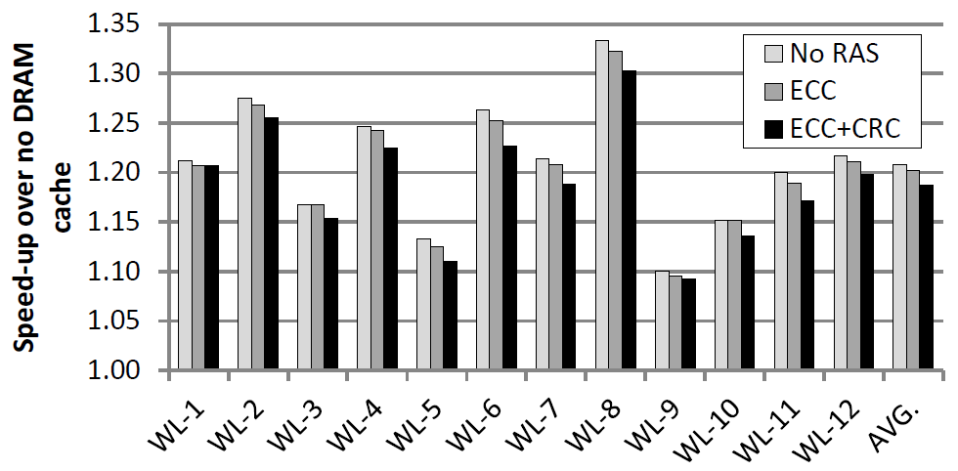
Performance Impact
Latency increases by one memory clock for ECC check
Tag update increases to compute new CRC (on a write)
Capacity reduced for CRC case
-0.5% (-2.4% of speedup)
-1.7% (-8.2% of speedup)
See paper for full methodology details. 4-core, multi-programmed SPEC06 workloads; per-core
L1 caches, shared L2, and shared L3 DRAM cache (8 x 128-bit channels)

Slide 14
Coarse-Grain Failures

Slide 15
Types of Failures
Multi-bit upset
  Smaller cells can increase likelihood that a particle strike upsets more than one cell
    SEC(DED) only corrects one bit; higher-level codes are expensive
Read/write circuitry or bus failure
  64B cache line = 512 bits → 4 bits of data transmitted per bit of the bus
    A failed driver, broken TSV, etc. causes up to 4 incorrect bits (again, too much for SEC)
Row decoder failure:
  Problem in the address decoding
  path could lead to the wrong
  wordline being asserted
    Standard ECC can’t help you here
Entire bank failure
  Power delivery problem, precharge/timing
  circuitry failure, bank decoder failure
Entire channel failure
  Similar to above
Row 110001
Row Decoder
Row 101110
Row 101111
X
E(X)
Row 110000 ← accessed row
Y
E(Y)
Row 110001 ← requested row
Row 110010
ECC✓
No error!

Slide 16
First Step: Detection
CRC catches errors within a row
  Multi-bit errors
  A failed row, bank, channel likely to generate garbage output – CRC will catch these
For decoder errors, use technique like Argus [Meixner+ MICRO’11]
10111010101001001001010110110101
ECC
01001011
cat
1100001100001100001100001100001100001100
XOR
0111100110101000101001010111011001000111
N copies of row index (110000)
XOR
10111010101001001001010110110101
01001011
ECC checks out

Slide 17
First Step: Detection
Say we now request row 110001, but due to a decoder fault,
we are given row 110000 instead
Row 110001
Row Decoder
Row 101110
Row 101111
Row 110000 ← accessed row
Row 110001 ← requested row
Row 110010
1100011100011100011100011100011100011100
0111100110101000101001010111011001000111
N copies of row index (110001)
XOR
10111110101101001101010010110001
01011011
ECC detects multiple errors

Slide 18
Inspiration From Disk: RAID-1
Store redundant copy (copies?)
  See “In Cache Replacement” [Zhang+ DSN’03]
Bank 0
Bank 1
Bank 2
Bank 3
Bank 4
Bank 5
Bank 6
Bank 7
A
☹
C
A
C
B
B
D
D
ECC fail
Correct
Simple: original in bank x, place copy in bank x+4 (mod 8)
ECC/CRC detects corruption
Read value from duplicated copy
  Repair original
Works, but very expensive (half of your cache capacity is gone)

Slide 19
Duplicate-on-Write
RAID-1 for disk: no backing store
DRAM cache: off-chip (main) memory still has a copy
  If corrupt, just re-read from main memory
  Similar to parity-protection of I$
    Instructions never modified
But DRAM$ can have modified data
Only duplicate data on writes
  Capacity impact function of number
  of dirty cachelines
  In the worst case (entire cache is
  dirty), still could lose 50% of capacity
    Doesn’t happen in practice
Examples show duplication across banks for simplicity, but by duplicating across channels we get “channel-kill” protection
  If there are multiple DRAM stacks, then even “stack-kill” is plausible
DRAM$
A
B
Stale
☹
A
DRAM$
B
B
Write

Slide 20
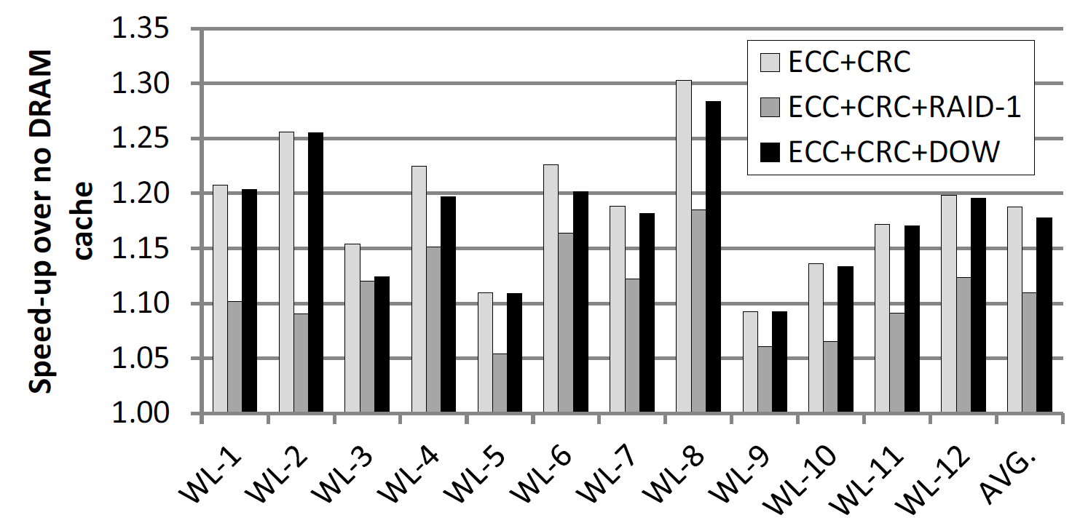
Performance Impact
Full duplication (RAID-1) clearly not good
Dirty duplication (DOW) relatively effective
  Speedup reduced from 19%→18% (1% loss, or 5.3% of DRAM$ benefit)
  Benefit: we can correct (almost) any error that we can detect
    Exceptions are very rare (e.g., original and duplicate copy both corrupted beyond repair)

Slide 21
Other Performance breakdowns
See the paper for:
  Breakdown of how capacity reduction vs. latency/bandwidth effects impact performance
  Analysis of additional write-back traffic due to DOW
  Analysis of amount of dirty data in the cache due to DOW
  DRAM cache size sensitivity analysis
  Additional performance results for additional workload combinations (210)

Slide 22
Failures at Scale
Raw FIT rates obtained via Monte Carlo simulation
  SDC FIT: number of SDC events per billion device hours
  DUE FIT: number of Detectable Uncorrectable Errors per BDH
  Assumed two device failure models: (1) Same as today, (2) 10x worse
Failure Rates | No RAS | ECC Only | ECC+CRC | DOW
SDC FIT | 234 | 41 | 0.0008 | 0.0008
DUE FIT | 0 | 37 | 52 | 0
Assume 100,000-node HPC system, four DRAM stacks per node
MTTF | No RAS | ECC Only | ECC+CRC | DOW
SDC | 10 hours | 60 hours | 350 years | 350 years
DUE | n/a | 68 hours | 48 hours | n/a

Slide 23
Summary & Conclusions

Slide 24
Generality
Paper provides a specific example implementation
  But this is really a framework, for example:
    SEC, DEC, or other for tags and data?
    Other detection/coding algorithms besides CRC?
All works with commodity stacked DRAM interface
  No changes from memory vendors needed
  All of the logic is in the DRAM-cache controller
Mix-and-match features as needed
  Cache controller can be designed to support more than one mode, for example:
    No RAS (highest performance, have full DRAM cache capacity)
    ECC-only
    ECC+CRC
    ECC+CRC+DOW
    Varying levels of any of the above (e.g., SEC ECC vs. DEC ECC)
  May not be able to change “on the fly” (i.e., need a reboot, or at the very least a cache flush), but don’t need to buy a completely new processor or system
Relatively small performance overhead for very high levels of RAS

Slide 25
Other Directions
What to do after a bank/channel/stack goes down?
  Sparing mechanisms
  Remapping of cache around failed resource(s); i.e., capacity reduction
DiRT for limiting dirty data to reduce DOW impact
  Dirty Region Tracker mechanism proposed by Sim et al. that bounds the amount of dirty cachelines in the DRAM$ [Sim+ MICRO’12]
Scrubbing/“Rinsing”
  Periodic error correction to prevent accumulations of multiple bit errors
  Periodic writeback of modified data to reduce DOW impact
System interactions
  Allow OS or other software to specify pages (or other granularity) to protect or not protect (or at what level)
  If error corrections happen too often, alert OS and possibly reconfigure the RAS mechanisms for higher levels of protection
RAS for non-cache 3D DRAM?
  This work focused on die-stacked DRAM as a cache; for some markets, the entirety of main memory may be stacked… how to provide RAS support?

Slide 26
Summary
Comprehensive error-detection and correction for DRAM caches
Many existing techniques, synthesized specifically for DRAM caches
Low-cost, Flexible, and General
Questions? שאלות?

Slide 27
Disclaimer & Attribution
The information presented in this document is for informational purposes only and may contain technical inaccuracies, omissions and typographical errors.
The information contained herein is subject to change and may be rendered inaccurate for many reasons, including but not limited to product and roadmap changes, component and motherboard version changes, new model and/or product releases, product differences between differing manufacturers, software changes, BIOS flashes, firmware upgrades, or the like. AMD assumes no obligation to update or otherwise correct or revise this information. However, AMD reserves the right to revise this information and to make changes from time to time to the content hereof without obligation of AMD to notify any person of such revisions or changes.
AMD MAKES NO REPRESENTATIONS OR WARRANTIES WITH RESPECT TO THE CONTENTS HEREOF AND ASSUMES NO RESPONSIBILITY FOR ANY INACCURACIES, ERRORS OR OMISSIONS THAT MAY APPEAR IN THIS INFORMATION.
AMD SPECIFICALLY DISCLAIMS ANY IMPLIED WARRANTIES OF MERCHANTABILITY OR FITNESS FOR ANY PARTICULAR PURPOSE. IN NO EVENT WILL AMD BE LIABLE TO ANY PERSON FOR ANY DIRECT, INDIRECT, SPECIAL OR OTHER CONSEQUENTIAL DAMAGES ARISING FROM THE USE OF ANY INFORMATION CONTAINED HEREIN, EVEN IF AMD IS EXPRESSLY ADVISED OF THE POSSIBILITY OF SUCH DAMAGES.
ATTRIBUTION
© 2013 Advanced Micro Devices, Inc. All rights reserved. AMD, the AMD Arrow logo and combinations thereof are trademarks of Advanced Micro Devices, Inc. in the United States and/or other jurisdictions. Other names are for informational purposes only and may be trademarks of their respective owners.

